Slide 1

Blog App
Backer Yousif

Slide 2

Framework/library
For developing this application there were multiple options to start with. But, to make the application look attractive while keeping it simple I have used the following technologies.
1. Front end (Html, CSS and JavaScript). With some fonts imported from google.
2. Backend (Nodejs and mongodB).

Slide 3
Overview Framework/library
If we consider the front end, then there is html in accordance with CSS and JavaScript. Html is used for making the frontend page while CSS is used for styling and making it more attractive. JavaScript on the other hand is used to control the response to the actions of the user. On the backend, upon the actions of the user on the frontend, we need some logic that can handle the action. So, Nodejs exposing the APIs with the database as mongodB is used. For each NodeJS API operation it is recorded in the database known as mongodB.

Slide 4

Reason to use Framework/library?
The specific reason for using these frameworks or libraries is that these frameworks are widely adopted and accepted and being the easiest to start with. For beginners like us we can easily adapt with it. Also, the acceptability and readability of these frameworks are way easier than any other framework.

Slide 5
How does it work?
For running the application first, we must go to the frontend at the file named index.html. This file named index.html is the starting point of the application.
Then we must go to the backend folder and run the command “npm run starts”. Application will be started at the port 3000. It is important that you have mongodB installed in your system with all the required files.

Slide 6
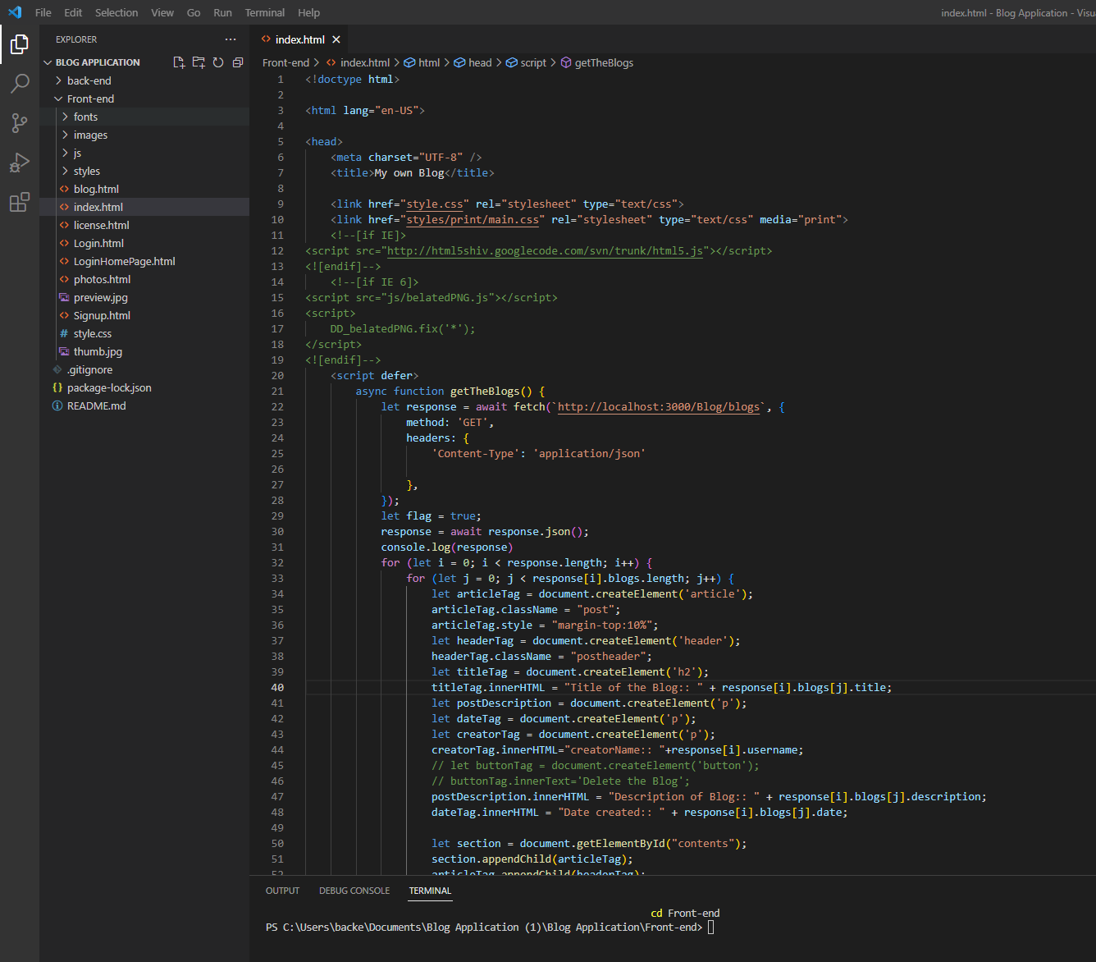
Front-End

Slide 7
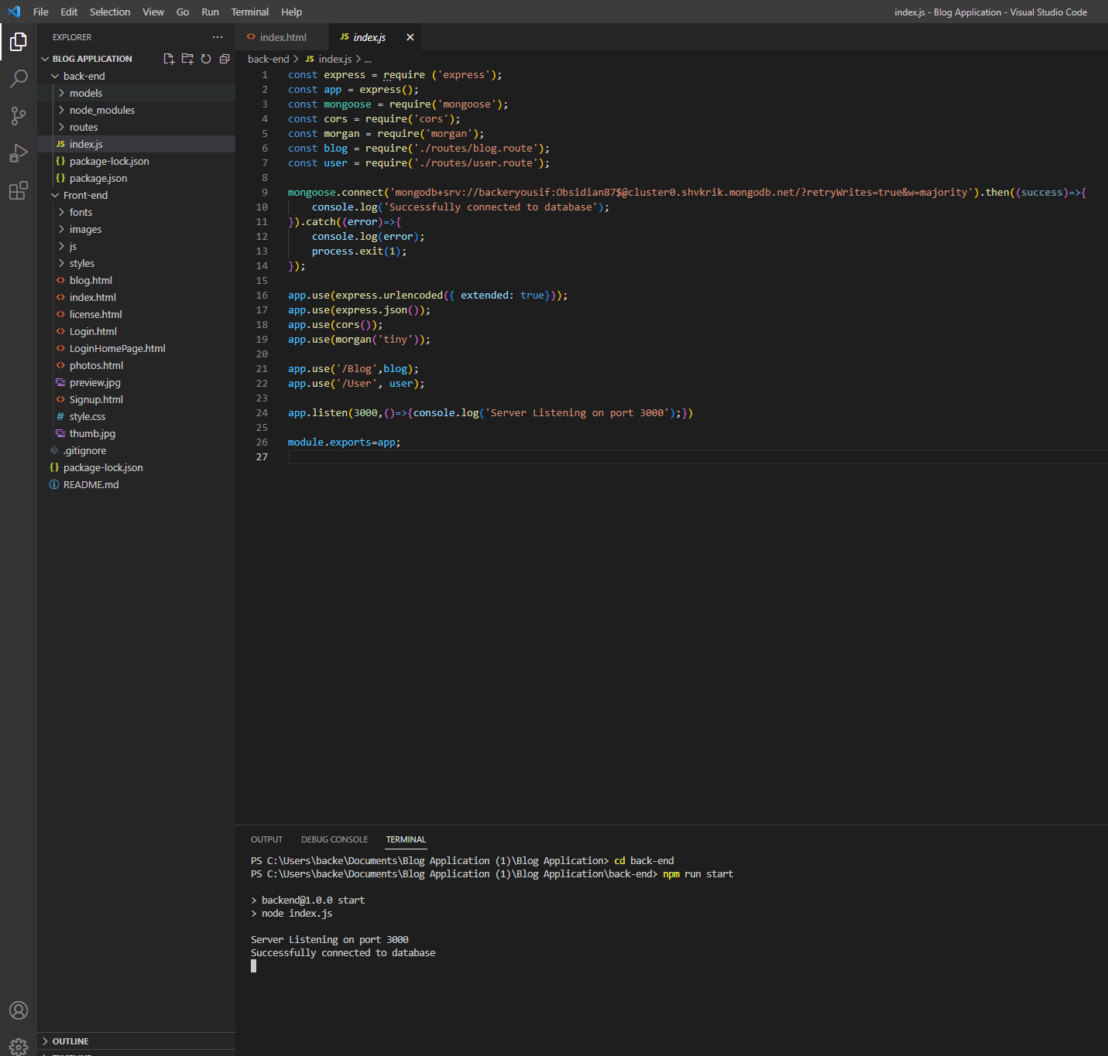
Back-End

Slide 8
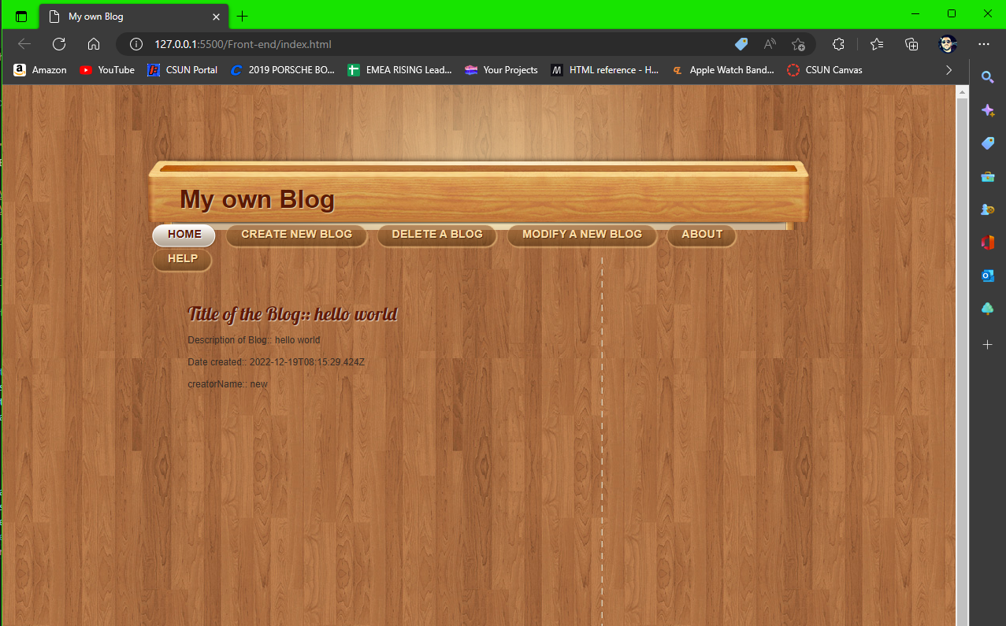
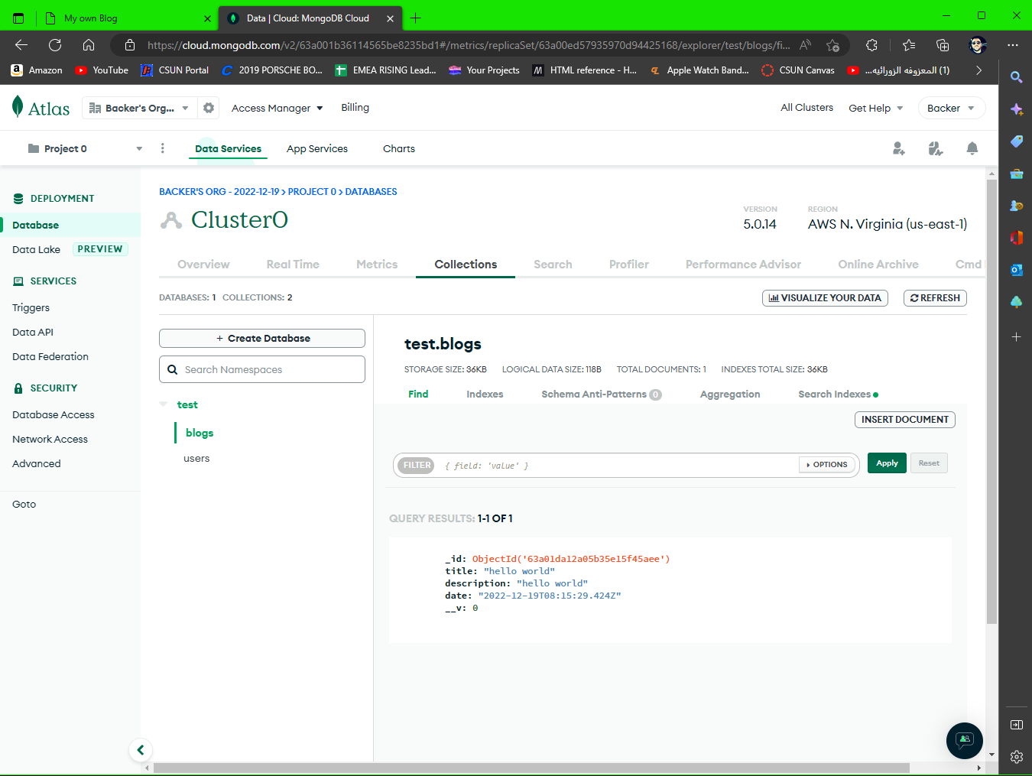
As you can see. The application starts running at the port 3000 which is the backend. The frontend is running with the live server.

Slide 9
Alternative Libraries
For the alternative we can use the React at the frontend. Backend might remain the same. The reason why react can be chosen is that it is one of the advanced framework on the frontend.

Slide 10
Pros & Cons
For the pros:
Easier to adopt and easier to start working.
Supports multiple frameworks on the backend.
Easier to enable it to work with the backend.
For the cons:
Must write JavaScript at the very basic level on the frontend.
For small functionality we must write code well.
For taking it might not exactly be a single page application.

Slide 11

Thank you

